Slide 1
Operation Analytics and Investigating Metric Spike
VICTOR SHAH

Slide 2
Project Description
As a Data Analyst collaborating with the Microsoft Product team, my primary responsibility is about identifying areas for improvement within the company.
The aspect of my role is to extract meaningful insights from the user data. These insights will offer actionable information for various teams within the business. •
The Operational Analytics is a crucial process that involves analysing a company's end-to-end operations. One of the key aspects being Investigating metric spikes.
The goal is to empower the product manager and the entire team with actionable insights that will shape the future development and user experience in the application.

Slide 3
Approach
Importing the Dataset: The first step is maintaining a file path to export data (.csv) into the SQL workbench.
Understanding the Schema: The next step is to examine the structure of the table holding the data ( job_data, events, etc).
Identifying the Key tables: Identification of the primary key from each of the tables of job_data, email_events, events, users etc.
Checking for null values: Before the analysis, it is necessary to check for null values in the given tables
Visually Appealing: The SQL Queries need to be properly formatted so that they can be understood by any user.

Slide 4
CASE STUDY 1: Job Data Analysis

Slide 5
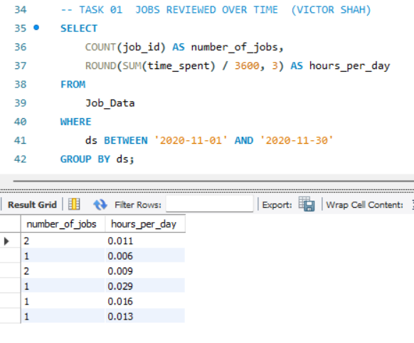
A. Jobs Reviewed Over Time:
Calculate the number of jobs reviewed per hour for each day in November 2020.

Slide 6
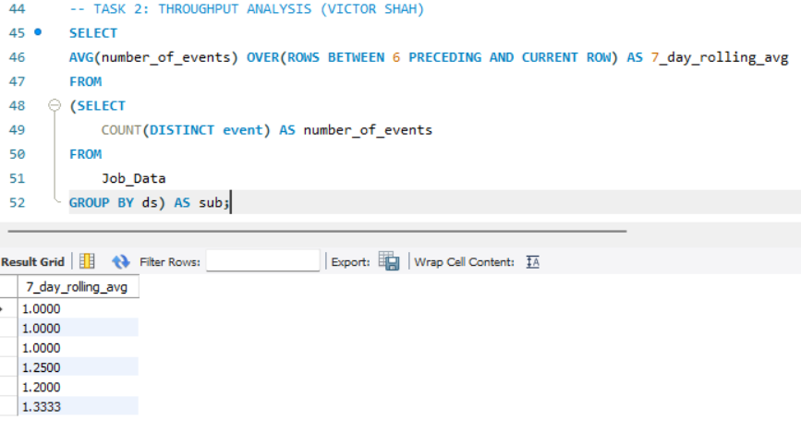
B. Throughput Analysis:
Calculate the 7-day rolling average of throughput (number of events per second).

Slide 7
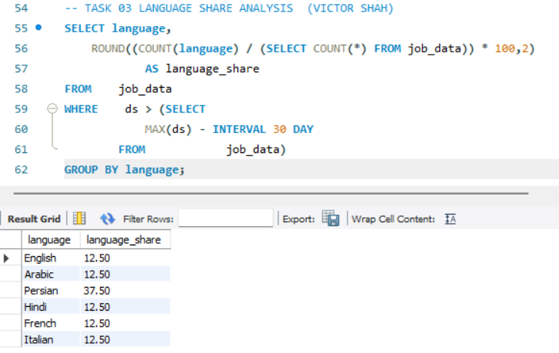
C. Language Share Analysis:
Calculate the percentage share of each language in the last 30 days.
The language Persian has the most share out
of the other languages in the past 30 days.

Slide 8
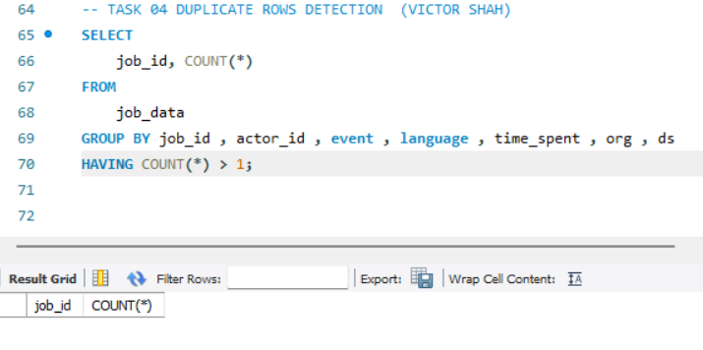
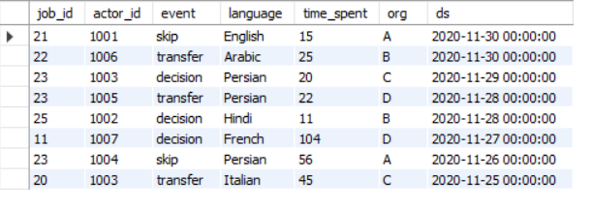
D. Duplicate Rows Detection:
Identify duplicate rows in the data.
The given table job_data has no duplicate rows. Hence the query returns an empty output.

Slide 9
CASE STUDY 2: Investigating Metric Spike

Slide 10
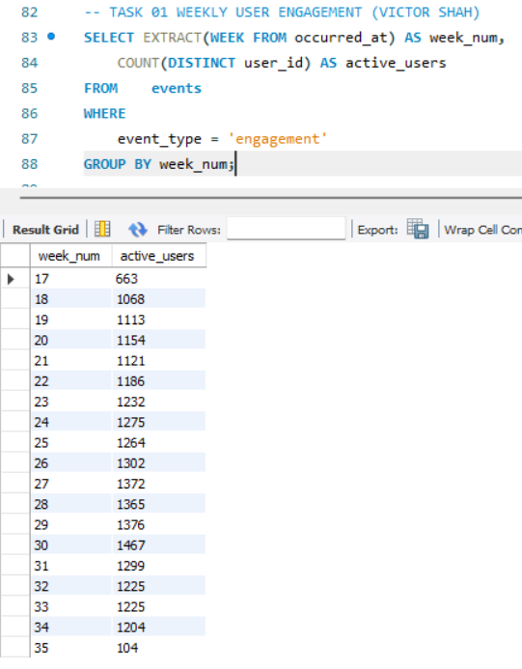
A. Weekly User Engagement:
Measure the activeness of users on a weekly basis.
We can see that the user's engagement is measured upon events like login, home_page, like_message, view_inbox.

Slide 11
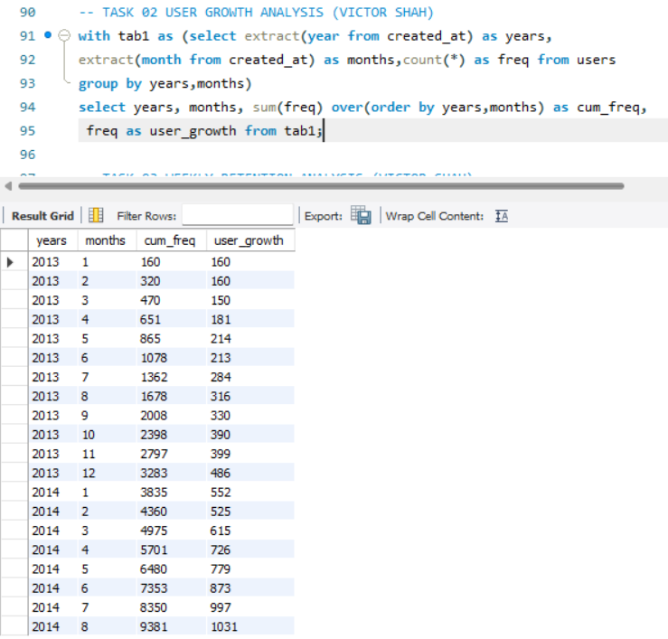
B. User Growth Analysis:
Analyze the growth of users over time for a product.
The cumulative frequency is used to determine the number of observations that lie above a particular value in a dataset.

Slide 12
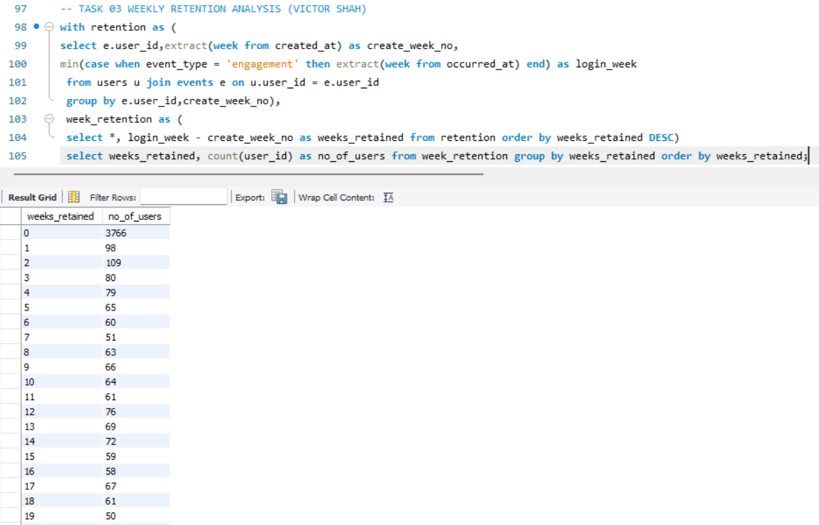
C. Weekly Retention Analysis:
Analyze the retention of users on a weekly basis after signing up for a product.
Week by week we can see the number of active users start to deteriorate.

Slide 13
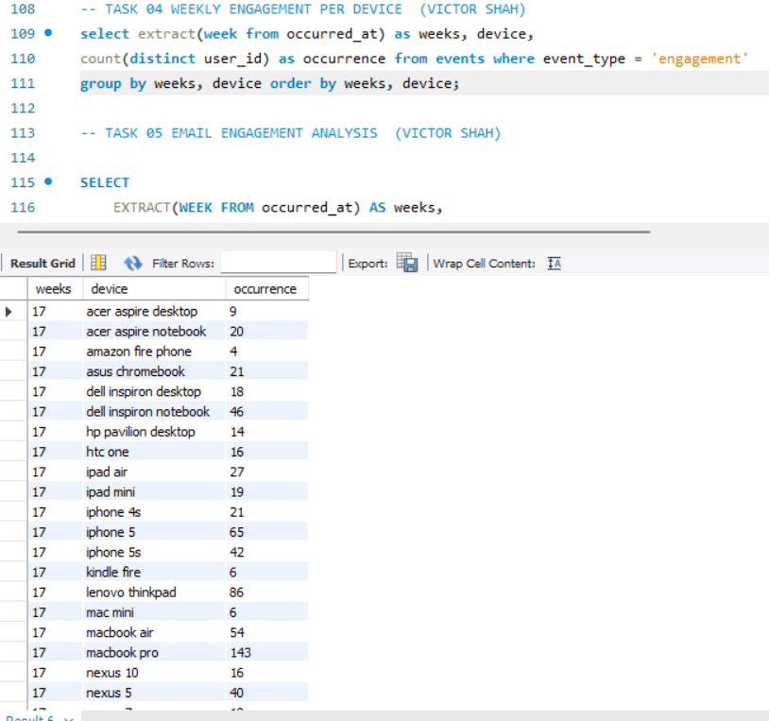
D. Weekly Engagement Per Device:
Measure the activeness of users on a weekly basis per device.
The users are differentiated weekly by the devices they use concurrently. The count of these devices are measured.

Slide 14
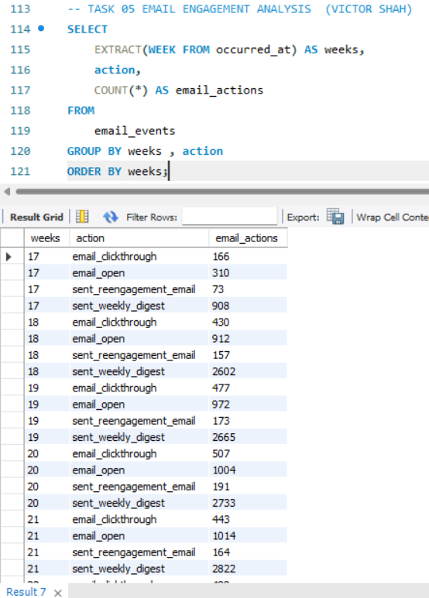
E. Email Engagement Analysis:
Analyze how users are engaging with the email service.
We are able to figure out the events occurred in the email like email_clickthrough, email_open, sent_weekly_digest and many more.

Slide 15
Tech-Stack Used
MySQL Workbench(8.0.34): This is the primary interactive development environment for SQL queries. It enables efficient query building, execution and debugging for data analysis
SQL commands:
DDL commands: These commands were used for the creation of the database and the multiple tables such as users, job_data, email_events, events.
DML commands: These commands were used for the insertion of the data into the records of the table.
DQL commands: The select query with where, order by, group by clauses helped for the further analysis of the data from the table.
Window Functions: Does calculationn across a set of rows that are related to the current row. These functions are used when we want to calculate Average Running Price, Running Total Orders, Running Sum Sales, Rank and Percentile.

Slide 16
Insights
While analysing the tables we were able to figure the jobs reviewed per hour for each day in November 2020.
The identification of duplicate rows from the table.
We were able to understand how different users engage with email events in the application.
The span of every language share in the last 30 days.
To be able to analzye the retention of users on a weekly basis after signing up for a product..

Slide 17
Result
Remembering to adapt these queries on specific database schemas.
These learned insights helped me understand specific business questions which were addressed by SQL queries.
Learning about the SQL clauses such as the join clauses and sub-queries. The importance of order by and group by and many more.
We were able to import the dataset from a .CSV file into the SQL workbench for performing analysis.
Achieving the ability to learn and write SQL queries to execute different business questions.
Solving business related problems using Windows functions of SQL.

Slide 18
Thank you

